Slide 1
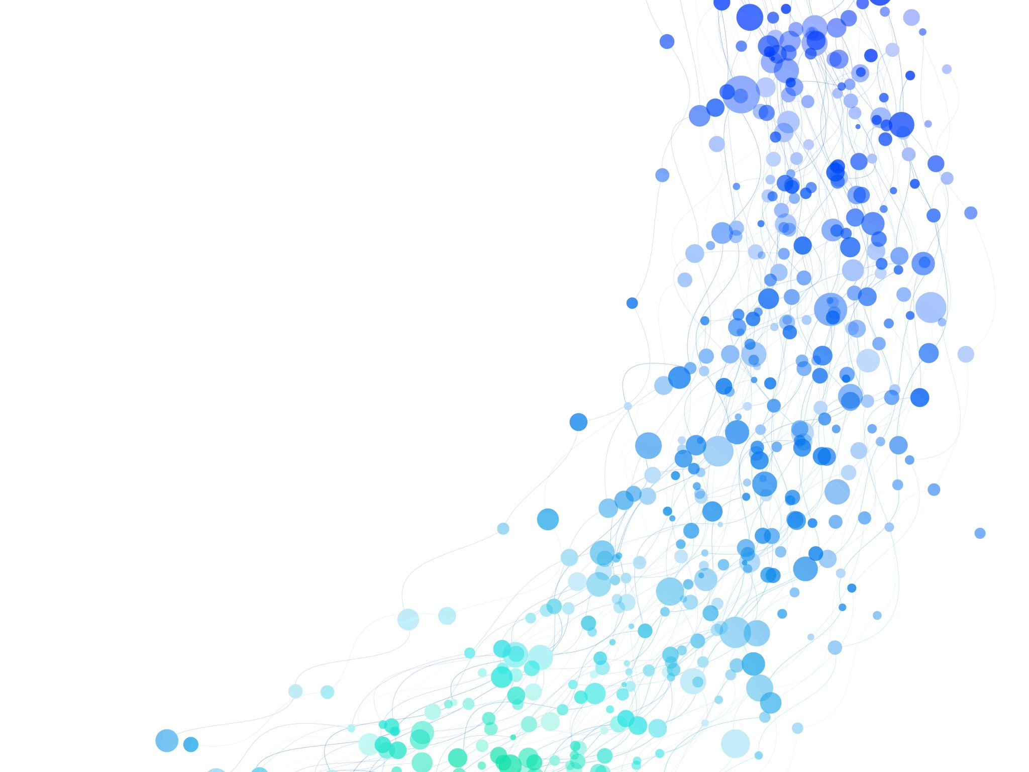
Exercise 11 of Applied Biostatistics II
Hector Arribas Julian Niklaus Matthias Rubin

Slide 2
Setup of the experiment
A scientist is interested in how genotype of a strawberry plant affects fruit yield. There are three levels of genotype (AA, AB, BB) and ten plots of land, three plants per plot. Each of the three genotypes is present in each plot.
Perform an ANOVA, assuming one-way randomized block design.
Repeat the analysis of variance without taking into account land effects.
Compare the results in a) and b). Why are the degrees of freedom different? Which result would you use?

Slide 3

Layout of the experiment
Plot 1
AA
BB
Plot 9
AA
AB
Plot 10
AA
AB
Plot 2
Plot 5
Plot 6
Plot 7
Plot 8
Plot 4
Plot 3
AB
AA
AB
BB
AA
AB
BB
AA
AB
BB
AA
AB
BB
AA
AB
BB
AA
AB
BB
AA
AB
BB
BB
BB
Image by brgfx on Freepick [1]

Slide 4
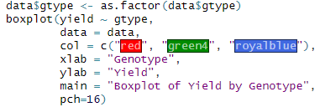
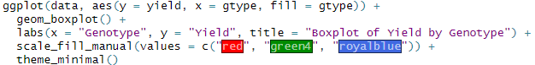
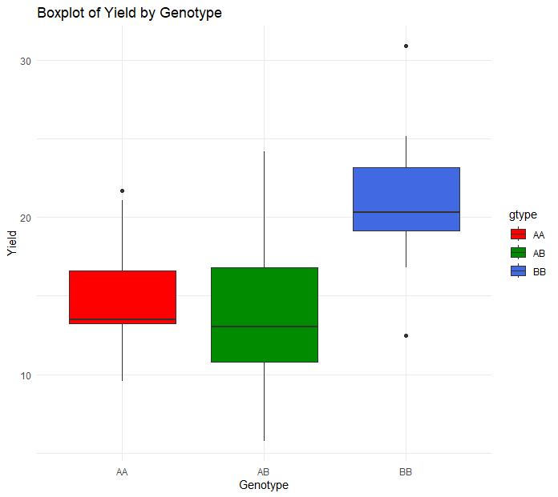
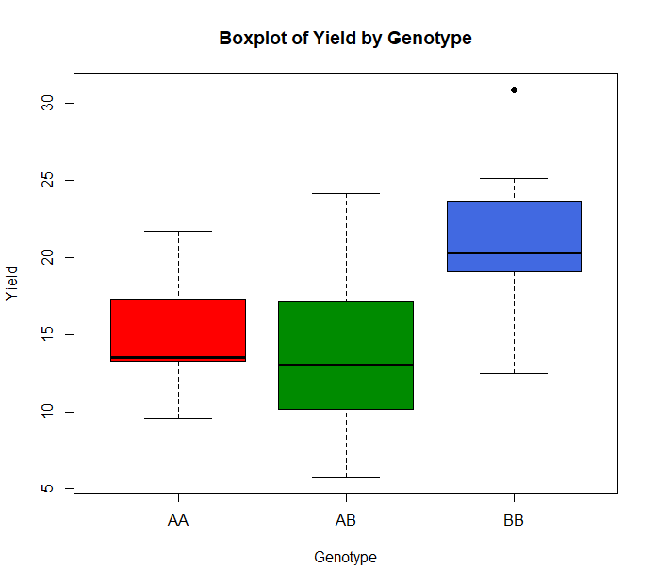
Base R
ggplot
Notes:
Here's what each component of a boxplot represents:
Median (Q2): The line inside the box represents the median of the dataset. It divides the data into two halves, with 50% of the data points falling below the median and 50% above.
Box (Interquartile Range, IQR): The box extends from the lower quartile (Q1) to the upper quartile (Q3). The length of the box represents the interquartile range (IQR), which contains the middle 50% of the data. The upper and lower boundaries of the box indicate the 25th and 75th percentiles of the data, respectively.
Whiskers: The whiskers extend from the edges of the box to the minimum and maximum values of the dataset, excluding outliers. The length of the whiskers is typically 1.5 times the IQR. Observations beyond the whiskers are considered outliers and are plotted individually as points.
Outliers: Individual data points that fall outside the whiskers are plotted as outliers. They are represented as points beyond the whiskers.

Slide 5
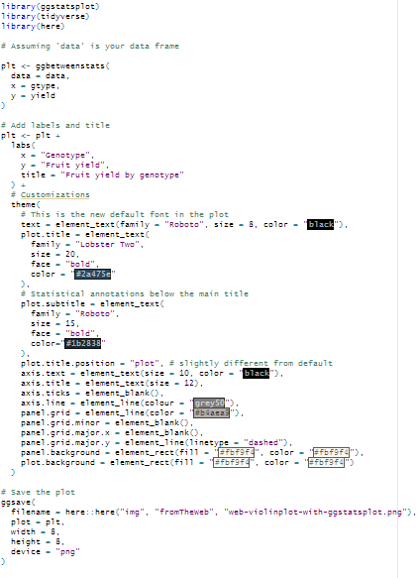
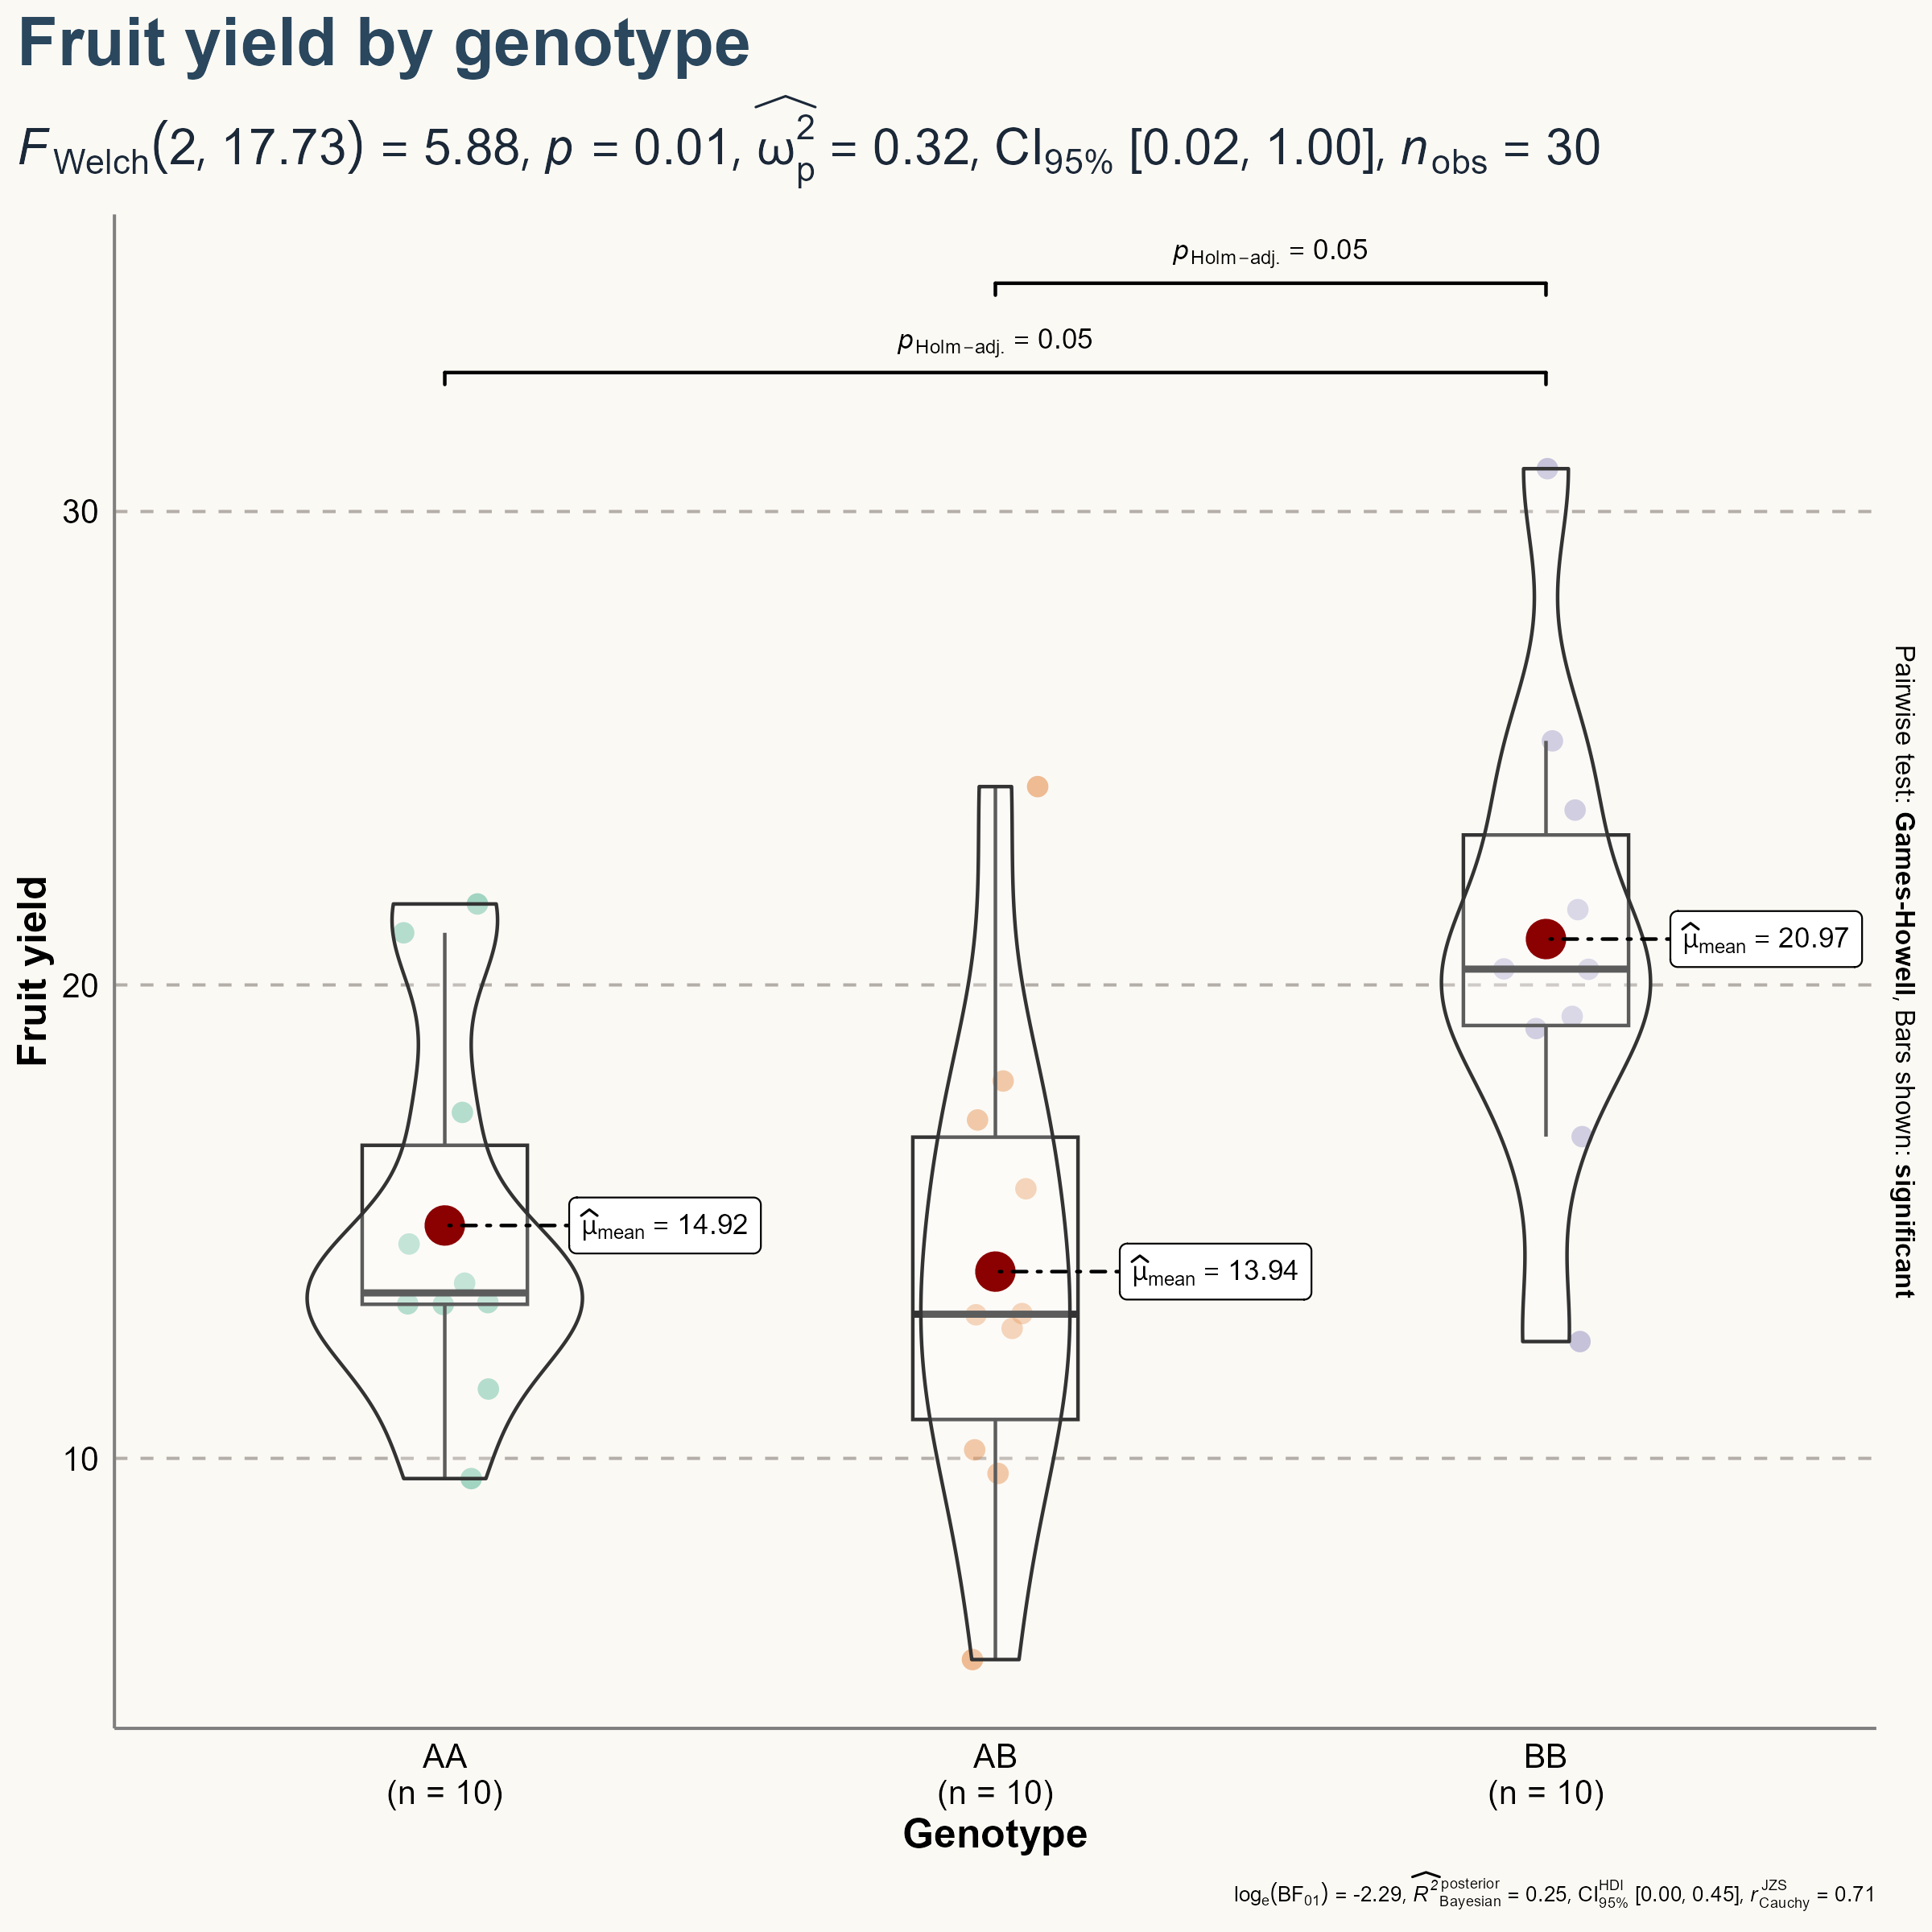

Slide 6
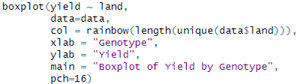
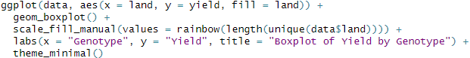
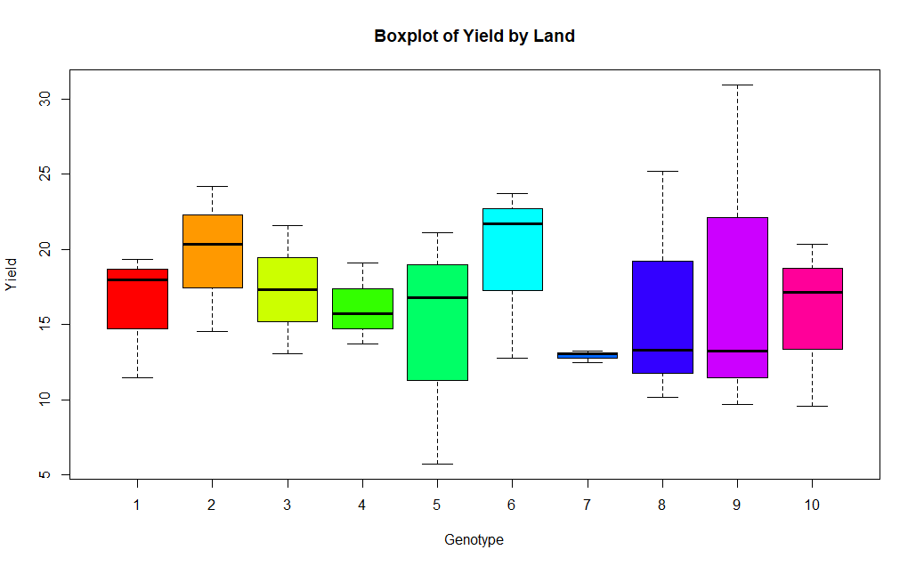
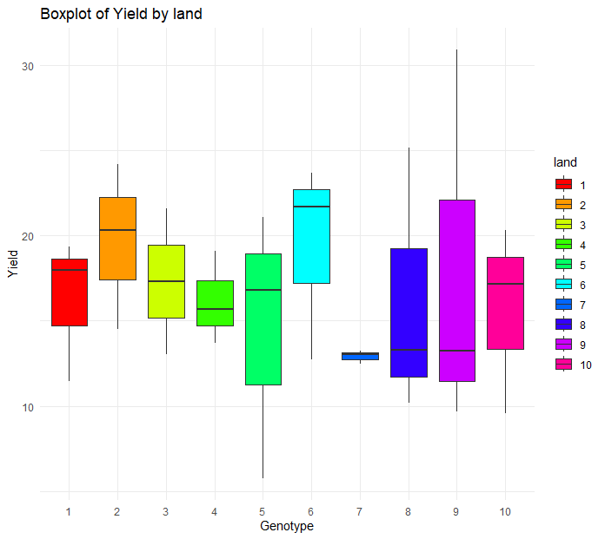
Base R
ggplot

Slide 7
a) Perform an ANOVA, assuming one-way randomized block design
ANOVA (ANalysis Of VAriance)
Basic idea: compare variance within groups to variance between groups
Basic assumption: variance (“amount of randomness”) is the same in each group
We test: H0: μ1 = μ2 = μ3 => All genotypes share the same mean fruit yield
Alternative H1: One or more means are different from the others

Slide 8
a) Perform an ANOVA, assuming one-way randomized block design
A type of experimental design used in statistical analysis:
One-way: There is only one factor (genotype of strawberries) being studied. We want to determine if it has significant effect on the fruit yield.
Block: The land grouped into blocks. Purpose:
Account for unwanted variability between plots of land (e.g., soil effects)
Increase the precision of the estimates of genotype effects.
3.Randomized: The assignment of genotypes to plots of land is done randomly. This ensures that any observations are not due to systematic biases or other factors related to the plots of land.
Notes:
A one-way randomized block design is a type of experimental design used in statistical analysis. In this design:
One-way: There is only one factor (or independent variable) being studied. In other words, there is only one treatment or condition that varies among the experimental units.
Randomized: The assignment of experimental units to treatments is done randomly. This randomization helps to ensure that any observed differences between treatments are due to the treatments themselves and not to systematic biases or confounding variables.
Block: Experimental units are grouped into blocks based on some known or suspected source of variability that is not of primary interest in the study. Blocking helps to reduce the variability within each block and increases the precision of the estimates of treatment effects.
In the context of the example provided earlier:
Factor: The genotype of the strawberry plant (levels: AA, AB, BB) is the factor being studied. This is the variable of primary interest, and we want to determine if it has a significant effect on fruit yield.
Randomized: The assignment of genotypes to plots of land (blocks) is done randomly to ensure that any observed differences in fruit yield between genotypes are not due to systematic biases or confounding factors related to the specific plots of land.
Block: The plots of land are grouped into blocks. Each block represents a different plot of land, and the purpose of blocking is to account for potential variability between plots of land that is not of primary interest in the study. Blocking helps to reduce the variability within each block and increases the precision of the estimates of genotype effects.
Overall, a one-way randomized block design allows researchers to control for sources of variability that are not of primary interest in the study, thereby increasing the validity and reliability of the conclusions drawn from the analysis.

Slide 9
In the context of this analysis, the land column is being treated as a blocking factor. Blocking is a design technique used to account for potential sources of variability that are not of primary interest in the study, but which may influence the response variable.
In the given scenario, the scientist is interested in studying how the genotype of a strawberry plant affects fruit yield. However, there are 10 plots of land, and each plot contains all three genotypes (AA, AB, BB). By treating land as a blocking factor, we are accounting for the variability between different plots of land.
Including land as a blocking factor in the model helps to control for potential differences between plots of land, such as soil fertility, sunlight exposure, or other environmental factors. This allows us to more accurately assess the effect of genotype on fruit yield by reducing the influence of these extraneous factors.
By specifying Error(land) in the ANOVA model, we are treating land as a random blocking factor, indicating that the plots of land were randomly selected from a larger population of possible plots. This helps to ensure that the conclusions drawn from the analysis are generalizable beyond the specific plots of land included in the study.
In summary, treating land as a blocking factor in the analysis helps to control for potential sources of variability and improves the validity of the conclusions drawn about the effect of genotype on fruit yield.

Slide 10
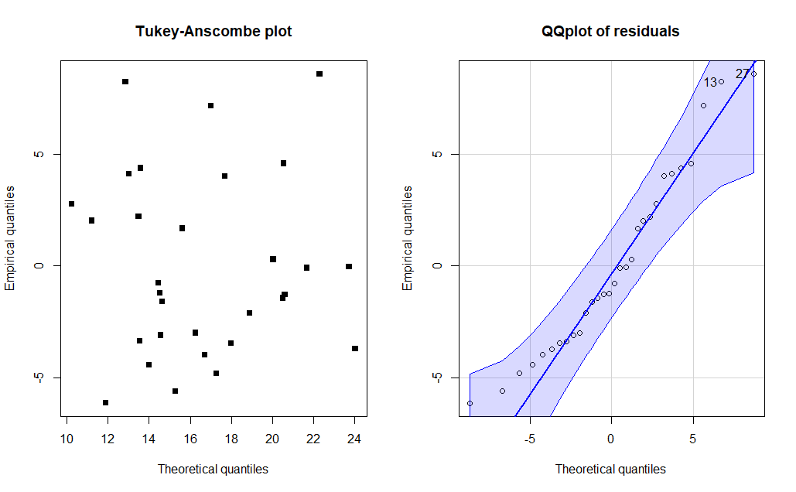
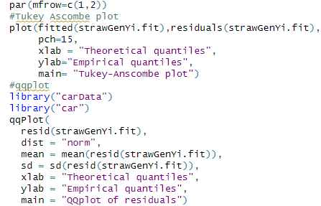
a) Perform an ANOVA, assuming one-way randomized block design
Model
Check assumptions
Notes:
Since land is a categorical variable representing different plots of land, it should be converted to a factor after reading in the data. This ensures that R treats it as a categorical variable and includes it appropriately in the analysis.
Categorical Variable Treatment: In statistical modeling, factors or categorical variables represent groups or levels of a factor. By converting 'land' to a factor, we explicitly specify that the variable represents distinct categories (i.e., different plots of land). This ensures that R treats 'land' appropriately as a categorical variable rather than as a continuous variable.
Correct Interpretation of Model Effects: When 'land' is treated as a factor, each level of the factor (i.e., each plot of land) is treated as a separate group. This allows us to estimate and interpret the effects of genotype (or other predictors) separately within each group (plot of land). Without converting 'land' to a factor, the interpretation of the model effects may not be accurate.
Blocking Factor in ANOVA: In the context of ANOVA, blocking is used to account for variability between different blocks (plots of land) that are not of primary interest in the study. Converting 'land' to a factor ensures that ANOVA treats 'land' appropriately as a blocking factor, allowing us to control for variability between plots of land and improve the validity of the statistical analysis.
Levels Identification: Converting 'land' to a factor also helps in correctly identifying the levels of the factor. Each unique value of 'land' will be treated as a separate level of the factor, allowing for proper grouping and analysis.

Slide 11
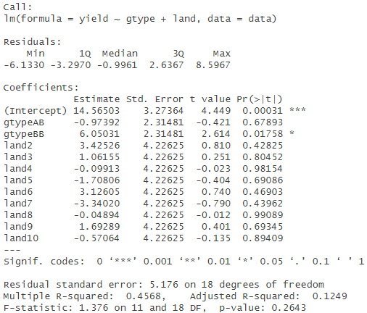
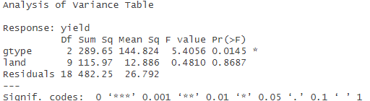
a) Perform an ANOVA, assuming one-way randomized block design
The factor genotype (gtype) is significant on a 5% level.
The block factor land does not seem to have an influence on the yield.

Slide 12
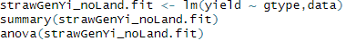
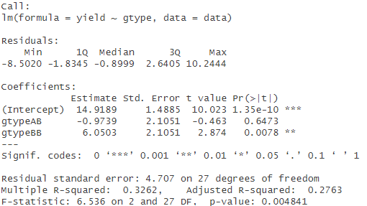
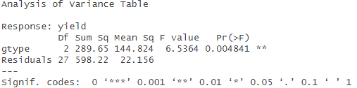
b) Repeat the analysis of variance without taking into account land effects
The factor genotype (gtype) is now significant on a 1% level.

Slide 13
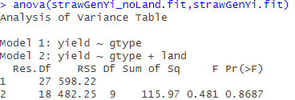
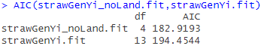
c) Compare the results in a) and b). Why are the degrees of freedom different? Which result would you use?
The factor genotype is more significant in the simple model
F-statistic is not statistically significant -> indicates that the full model does not provide a significantly better fit
AIC (Akaike Information Criterion) is lower for simple model -> better trade-off between model fit and complexity
Df are different because the total degrees of freedom in the model remain constant, but a portion of them are allocated to estimate the parameters of the added variables.
Notes:
This involves computing the F-statistic, which measures the ratio of the variation explained by the models to the unexplained variation.
Evaluate significance: Assess the significance of the F-statistic using the F-distribution. If the F-statistic is statistically significant (i.e., if the p-value is below a chosen significance level), this indicates that the full model provides a significantly better fit to the data than the simpler model.
The F-test compares the overall fit of nested models by testing whether adding additional variables significantly improves the fit of the model. It assesses whether there is a significant difference in the explanatory power of the two models.
On the other hand, the AIC is a measure of the relative quality of statistical models that balances goodness of fit and model complexity. It penalizes the inclusion of additional parameters, favoring simpler models that provide comparable or better fit to the data. A lower AIC value indicates a better trade-off between model fit and complexity.
In the context of linear regression, the total degrees of freedom are equal to the total number of observations minus the number of estimated parameters in the model.
When new predictor variables are introduced, more parameters need to be estimated to capture the relationship between these predictors and the response variable. Consequently, the degrees of freedom available to estimate the variability in the residuals (error terms) decrease as more parameters are allocated to estimate the additional predictors. This reduction in degrees of freedom for the residuals reflects the trade-off between capturing the complexity of the data and the precision of the estimation of residual variability.
number of estimated parameters would be 3: one for the intercept, one for the genotype variable, and one for the residual error term.
df_resid_simple = 30 - 3 = 27
In addition to the parameters for the intercept and genotype variable, parameters need to be estimated for the land variable as well. Assuming there are 9 unique levels of land (hypothetically), the number of parameters for the land variable would be 8 (one less than the number of levels). Therefore, the degrees of freedom for residuals in the full model would be:
df_resid_full = 30 - (3 + 8) = 30 - 11 = 19

Slide 14
References
1: <a href="https://www.freepik.com/free-vector/strawberry-plant-growing-with-soil- cartoon_25672980.htm#query=growing%20strawberries&position=0&from_view=keyword&track=ais&uuid=afdc4e99-9347-4eb4-adcd-0cf323320b31">Image by brgfx</a> on Freepik

